Slide 1

Ecommerce Purchase Prediction
Presented by Jeremy Alekai Stewart

Slide 2
Introduction
Client is an ecommerce company that wants to increase their sales revenue by targeting customers who are more likely to make a purchase.
Problem Statement:
Failure to identify which customers are more likely to make a purchase based on their purchase behavior. i.e. behaviour on the website.

Slide 3
A brief introduction to the dataset used
This dataset contains the online shoppers' behaviors and intentions from a leading Brazilian e-commerce company. The dataset consists of 12,330 online sessions from their website. 84.5% (10,422) didn’t purchase anything and the 15.5 % (1908) purchased one or more items.
Some of the data categories used in this analysis include:
Target/Goal:
Determine what factors influence the customer’s ability to make a purchase.
Customer location
Type of visitor
Type of browser used
day of the week
revenue
amount of time spent on a page etc.

Slide 4
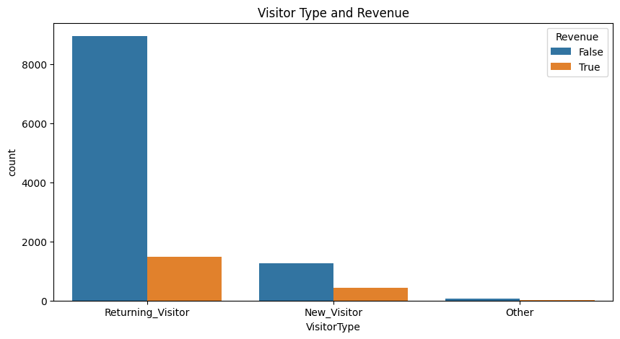
Visual 1 - Relationship Between Website Visitors and Revenue
Findings:
Returning visitors are more likely to make a purchase and they return because of quality goods and services..
Insight:
Emphasis on in-app advertisement because returning visitors are the one that are most likely to make a purchase
03

Slide 5
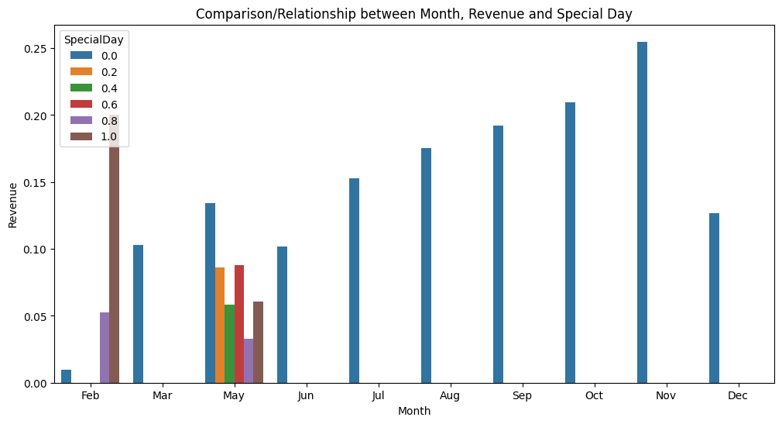
Visual 2 - Relationship Between Month, Revenue and Special/Public Holidays
Findings:
Certain months, such as November and October, appear to have higher sales than other months.
Visitors who visit the website on special days are more likely to make a purchase.
Insight:
Timing marketing and promotions around high-sales months could drive sales.
Creating targeted campaigns and promotions around special days could lead to increased sales
03

Slide 6
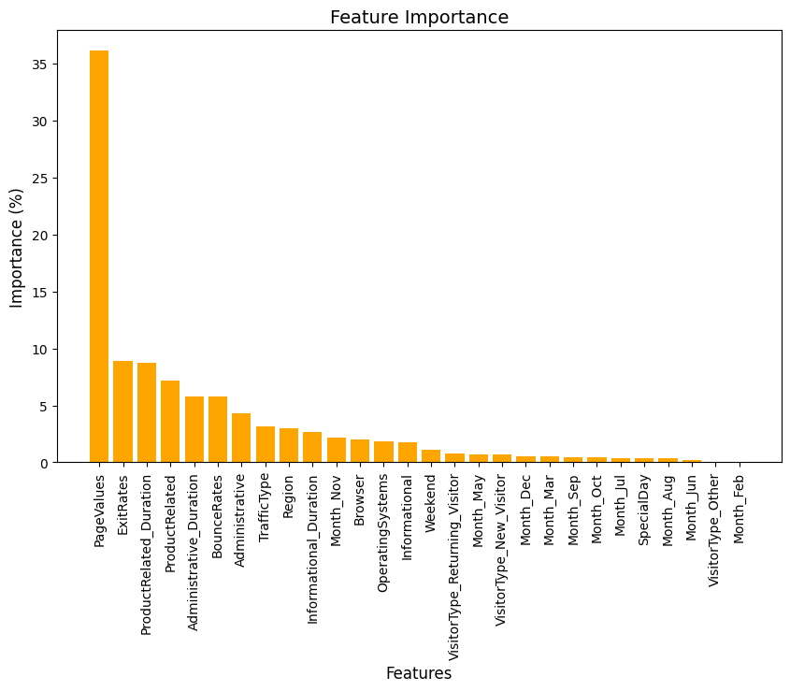
Visual 2 - Feature Importance
Findings:
All the below play a vital role in customers purchasing an item
No.of pages visited,
How quick someone leaves the page
Amount of time spent on a product
Insight:
Focus on the highly ranking features during development.
UI – prevent frequent exit rates and increase page values hence retention on the site.
03

Slide 7
Strengths and limitations
Strengths:
The model has a high accuracy in predicting when a customer is not going to purchase an item.
Limitations:
The model has a low accuracy in predicting when a customer is going to purchase an item. Though this can be improved upon.
Notes:
Strengths:
The model correctly predicts the outcome 90% of the time. (High Accuracy= 0.90)
The precision score of 0.93 for the False class suggests that when the model predicted the outcome to be False, it was accurate 93% of the time.
The recall score of 0.95 for the False class indicates that the model correctly identified 95% of all the actual False cases.

Slide 8
Recommendations
Emphasis on in-app advertisement because returning visitors are the one that are most likely to make a purchase.
Timing marketing and promotions around high-sales months could drive sales.
Creating targeted campaigns and promotions around special days could lead to increased sales

